Slide 1

Learning Traffic Deeply as Images with Partially Observed Data
Travel Time Prediction on I-80 E from Davis to West Sacramento
Jin Guo
06/04/2019

Slide 2
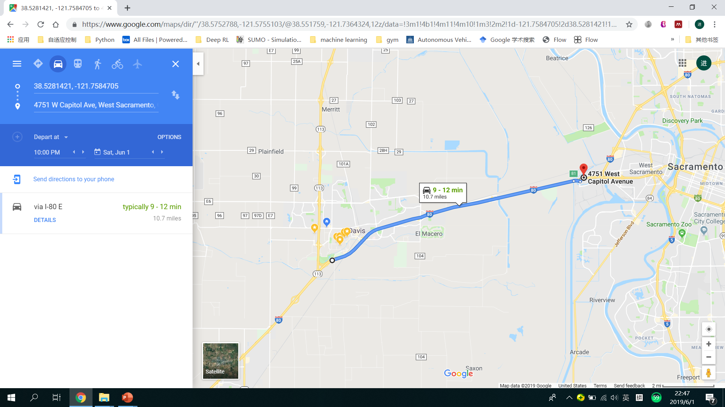

Travel Time
May 31, Friday, 7:00 AM
May 31, Friday, 4:00 PM
How is the color shown in Google Map related to our travel time?

Slide 3
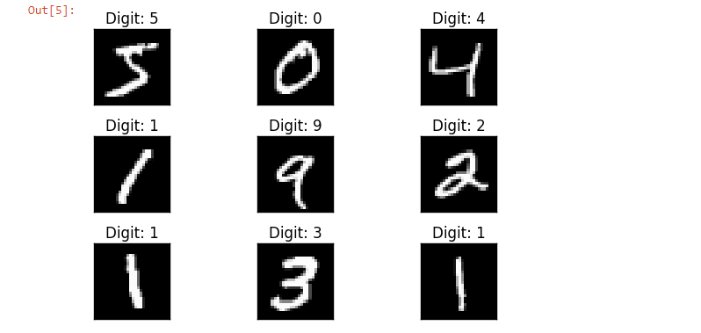
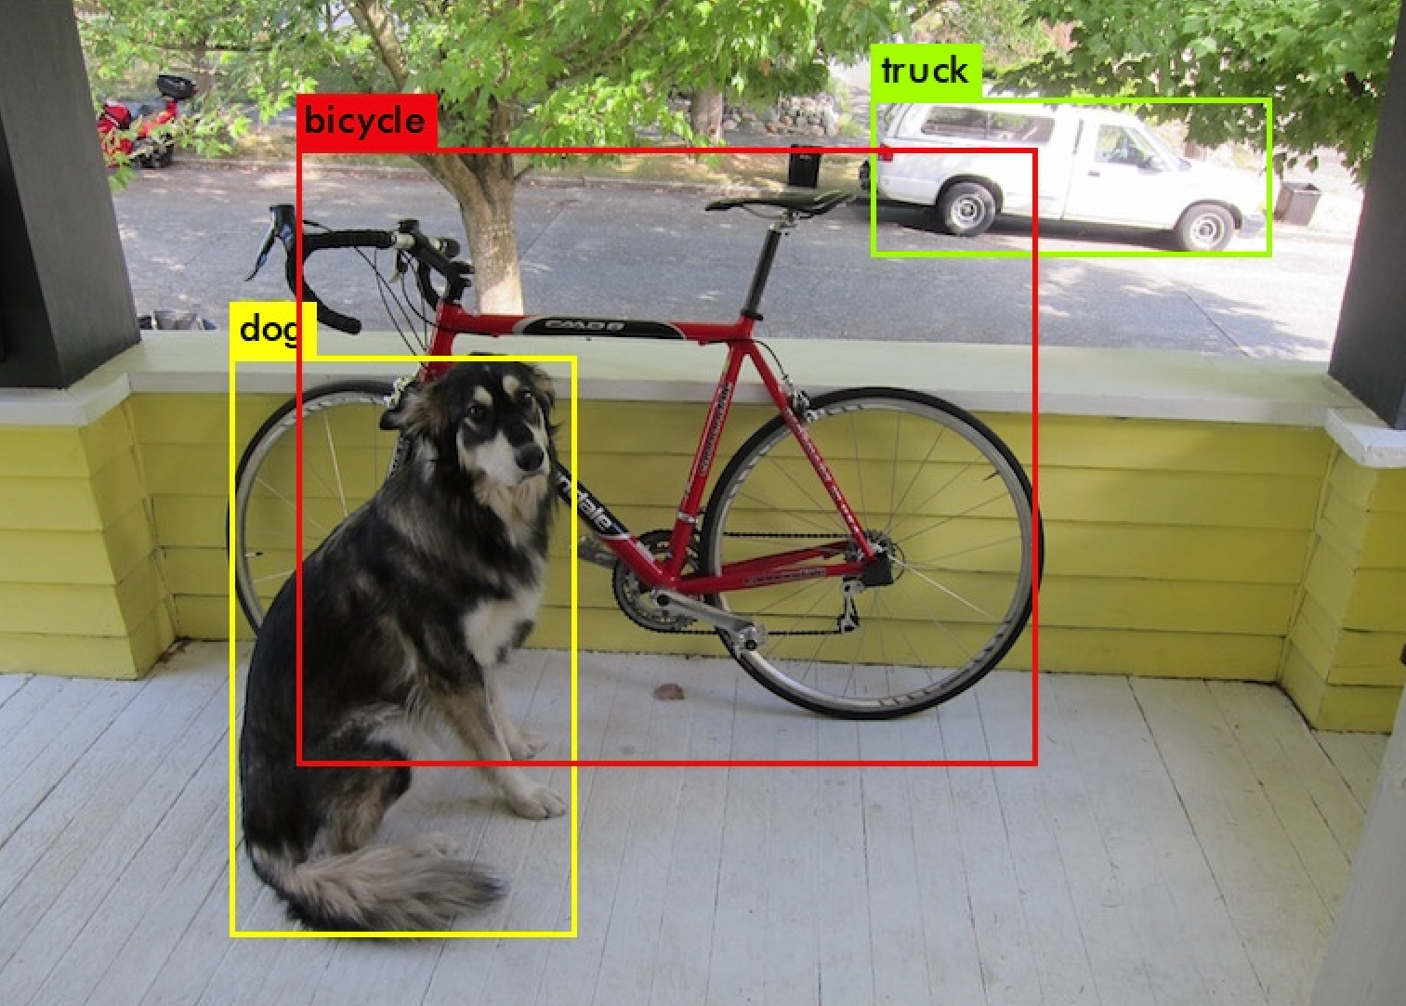
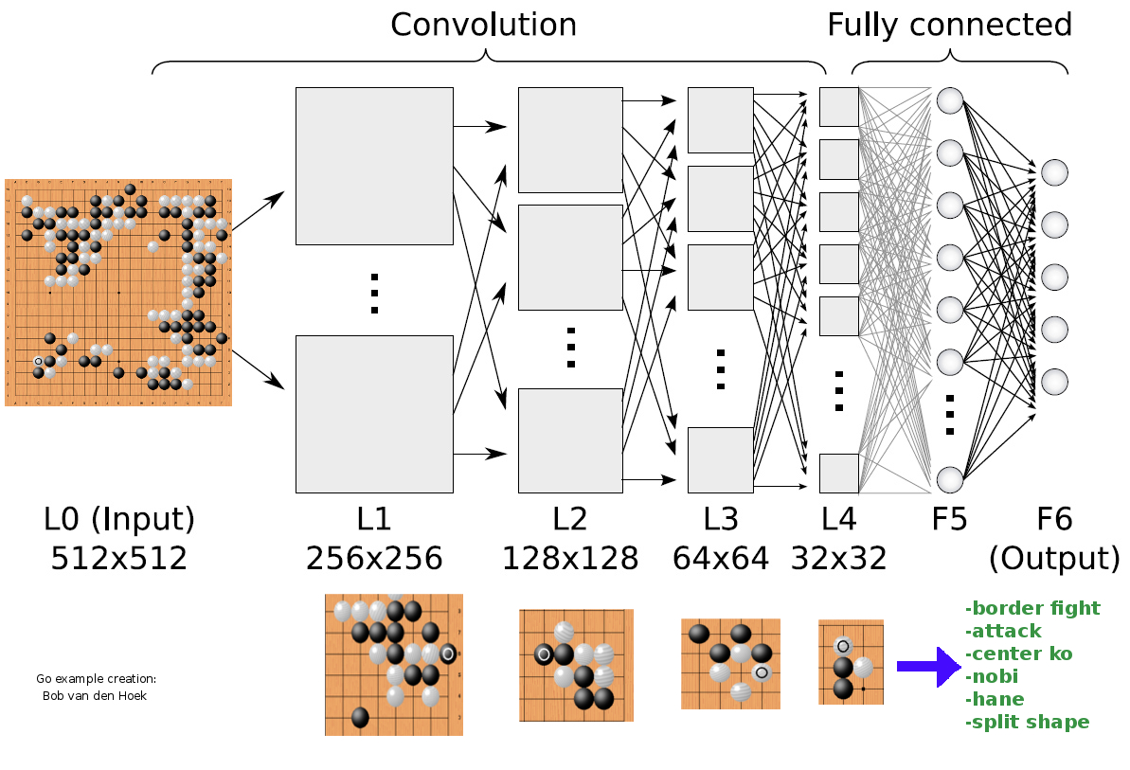
What Computer Vision Can Do Now?
Recognition of Hand Written Digits
Classification of Objects
Master of Go Games
Source: MNIST Data Set
Source: YOLO v3
Source: http://deeplearningskysthelimit.blogspot.com/2016/04/part-2-alphago-under-magnifying-glass.html
Is there another magic box that can tell us how many time we will spend on the road?

Slide 4



Three Steps to Build the Black Box
Collect and Preprocess Data
Convert Traffic Information to Images
Design and Train the Prediction Model

Slide 5
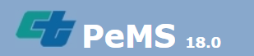
Data Collection
Caltrans Performance Measurement System (PeMS)
Vehicle Detector Station (VDS)
15 VDSs in the selected freeway segment

Slide 6
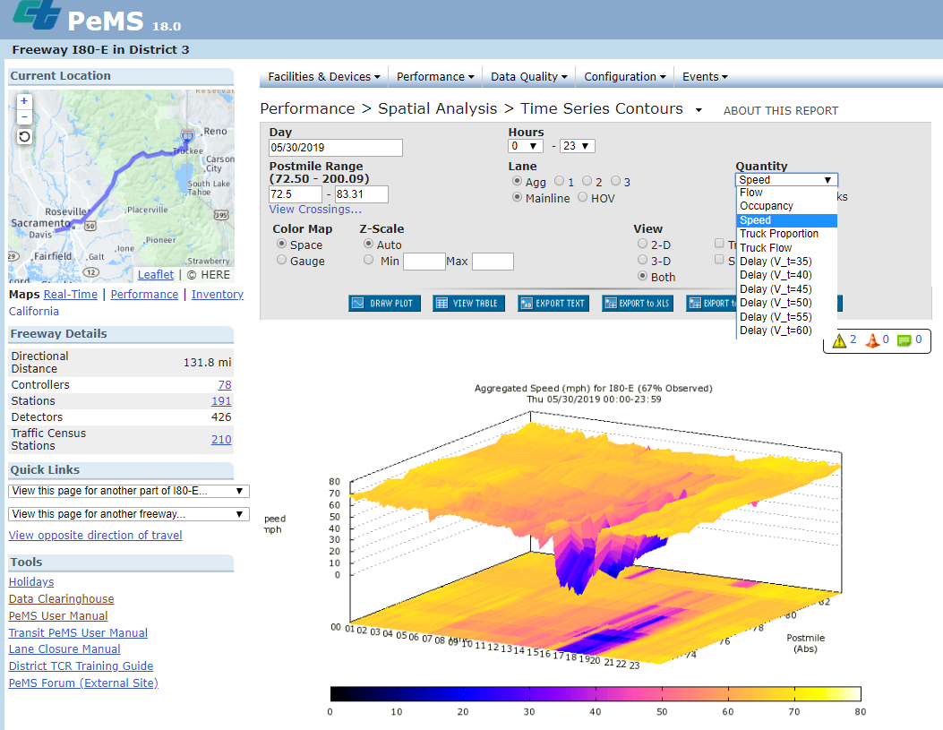
Data Collection
Time | AggOccupancy | AggFlow | AggSpeed | % Observed
00:00 | 0.01 | 40 | 67.40 | 100.00
00:05 | 0.01 | 19 | 67.40 | 100.00
00:10 | 0.02 | 43 | 67.30 | 100.00
00:15 | 0.01 | 68 | 68.00 | 0.00
00:20 | 0.01 | 89 | 67.40 | 100.00
00:25 | 0.01 | 67 | 67.40 | 100.00
00:30 | 0.04 | 68 | 67.40 | 100.00
00:35 | 0.02 | 76 | 67.40 | 100.00
00:40 | 0.02 | 67 | 67.40 | 0.00
00:45 | 0.03 | 97 | 67.40 | 100.00
00:50 | 0.02 | 59 | 67.40 | 100.00
00:55 | 0.04 | 57 | 67.40 | 100.00
01:00 | 0.02 | 0 | 67.40 | 33.33
01:05 | 0.02 | 68 | 67.40 | 100.00
Time
Occupancy
Flow
Speed
Observation rate
X 15 VDSs
X 17 + 1 + 1 Days
Training
Set
Test Set 1
Test Set 2
Same Detector Health
Different Detector Health

Slide 7
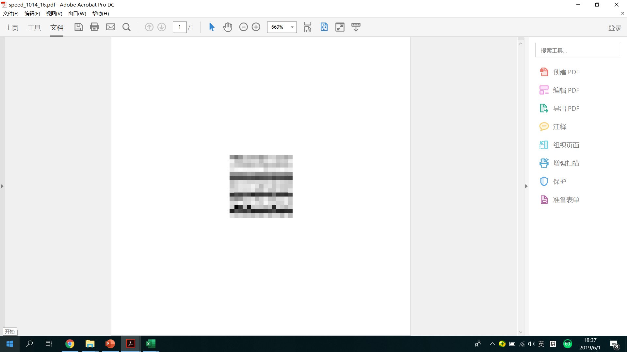



Convert Traffic Information to Images
VDS1
VDS2
….
pandas.read_excel( )
scipy.misc.imsave( )
VDS14
VDS15
t
t+5min …… t+5min*14

Slide 8
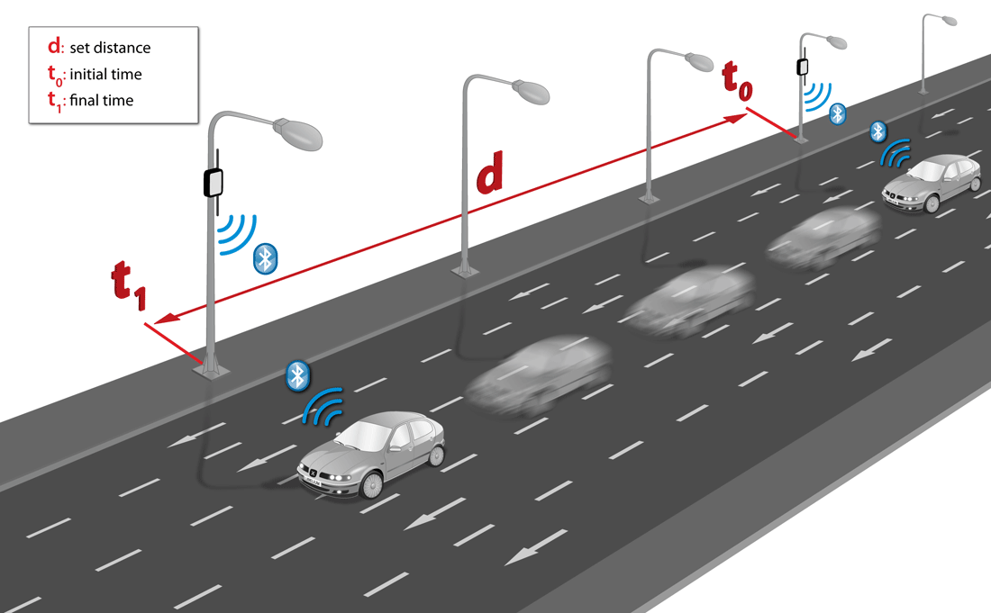

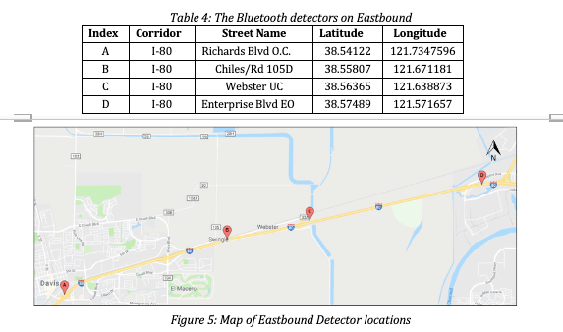
Travel Time Mesurement
V2I Technology
Source: https://icyapril.com/privacy/2016/11/21/tracking-drivers-through-their-phones.html
time | traveltime | segment | date
0.001991 | 185 | 80_Richards80_Chiles | 10/14/2018
0.002535 | 198 | 80_Richards80_Chiles | 10/14/2018
0.005081 | 181 | 80_Richards80_Chiles | 10/14/2018
0.005833 | 177 | 80_Richards80_Chiles | 10/14/2018
0.006701 | 206 | 80_Richards80_Chiles | 10/14/2018
0.007778 | 192 | 80_Richards80_Chiles | 10/14/2018
0.008368 | 222 | 80_Richards80_Chiles | 10/14/2018
0.009641 | 189 | 80_Richards80_Chiles | 10/14/2018

Slide 9
Travel Time Normalization
time | traveltime | segment | date
0.001991 | 185 | 80_Richards80_Chiles | 10/14/2018
0.002535 | 198 | 80_Richards80_Chiles | 10/14/2018
0.005081 | 181 | 80_Richards80_Chiles | 10/14/2018
0.005833 | 177 | 80_Richards80_Chiles | 10/14/2018
0.006701 | 206 | 80_Richards80_Chiles | 10/14/2018
0.007778 | 192 | 80_Richards80_Chiles | 10/14/2018
0.008368 | 222 | 80_Richards80_Chiles | 10/14/2018
0.009641 | 189 | 80_Richards80_Chiles | 10/14/2018
Every 5 minutes
Calculate mean μ and standard deviation σ
Aggregated Travel Time =
mean(i) for i >= μ - σ and i <= μ + σ

Slide 10
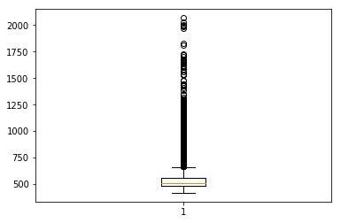
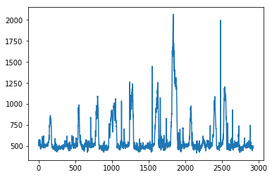
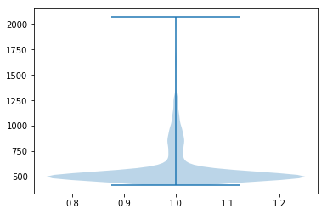
Travel Time Normalization
Box Plot of Travel Time
Time Series of Travel Time
Violin Plot of Travel Time

Slide 11
Travel Time Normalization
<450s
480s
510s
540s
570s
600s
630s
660s
690s
720s
>750s
0
1
2
3
4
5
6
7
8
9
Mph:
>80.0
75.0
70.6
66.7
63.2
60.0
57.1
54.6
52.2
50.0
<48.0
Regression → Classification

Slide 12

Pare Images with Travel Time
VDS1
VDS1
VDS2
VDS1
VDS1
VDS1
….
VDS1
….
….
….
….
….
VDS14
VDS14
Pytorch Tensors
VDS15
VDS14
VDS15
t
VDS14
t+5min …… t+5min*14
VDS15
t
VDS14
t+5min …… t+5min*14
VDS15
t
VDS14
t+5min …… t+5min*14
t
VDS15
t+5min …… t+5min*14
t
VDS15
t+5min …… t+5min*14
t
t+5min …… t+5min*14
TTt+5min*15
TTt+5min*15
TTt+5min*15
TTt+5min*15
TTt+5min*15
TTt+5min*15

Slide 13
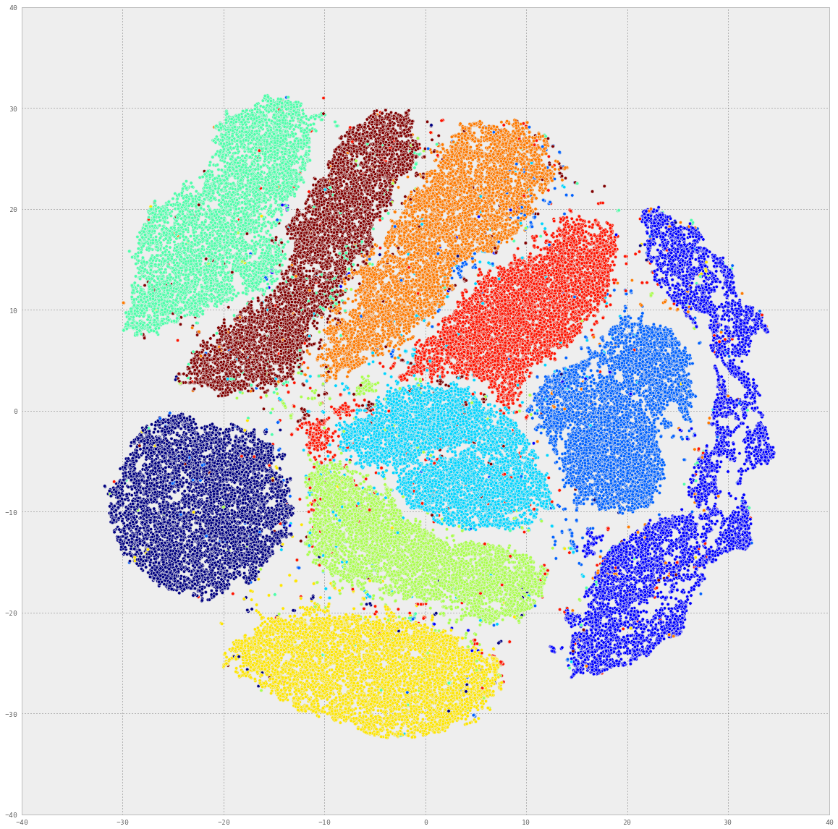
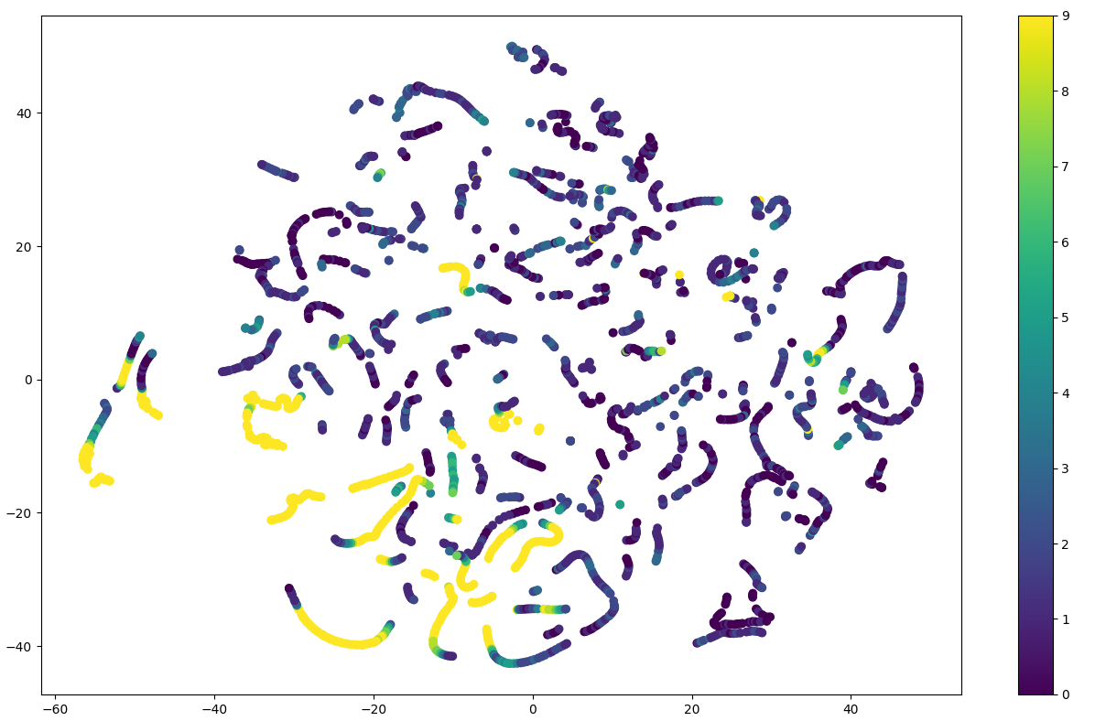
t - SNE
t-Distributed Stochastic Neighbor Embedding (t-SNE): visualization of high-dimensional datasets
Maaten, L. V. D., & Hinton, G. (2008). Visualizing data using t-SNE. Journal of machine learning research, 9(Nov), 2579-2605.
t – SNE for handwritten digits recognition
t – SNE for travel time prediction

Slide 14

Convolutional Neural Network (CNN)

Slide 15
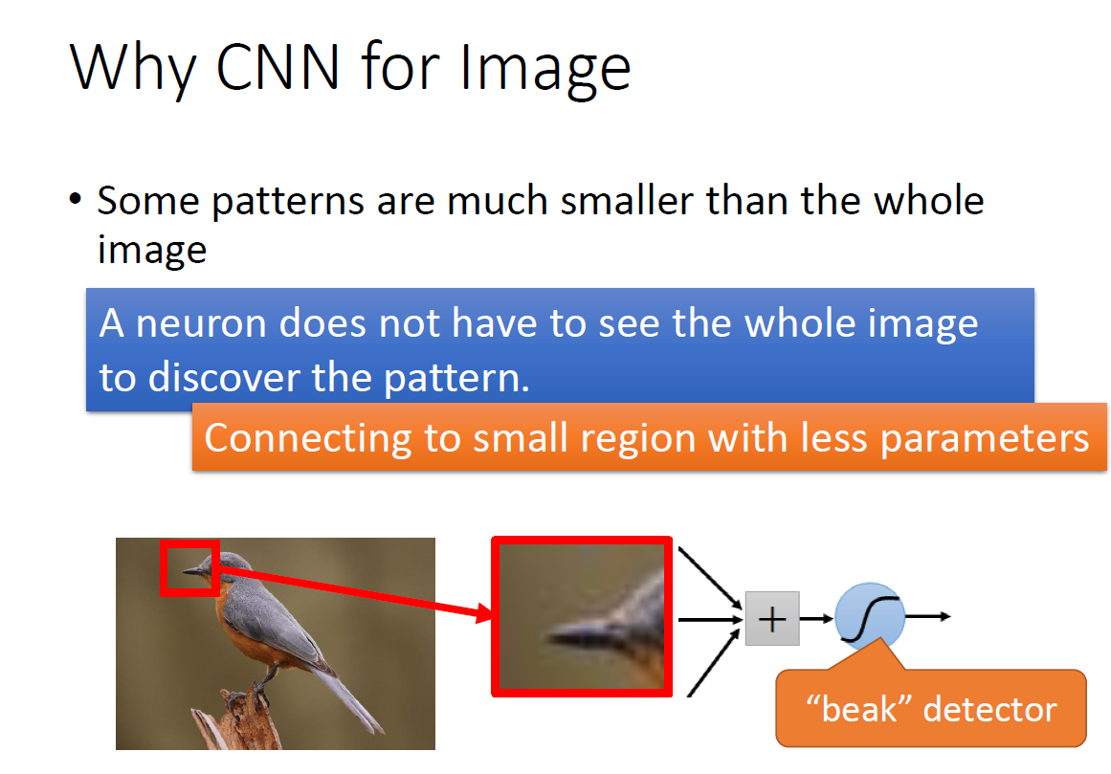
Convolutional Layers
Adjusted from Dr. Hung-yi Lee, Machine Learning slides

Slide 16
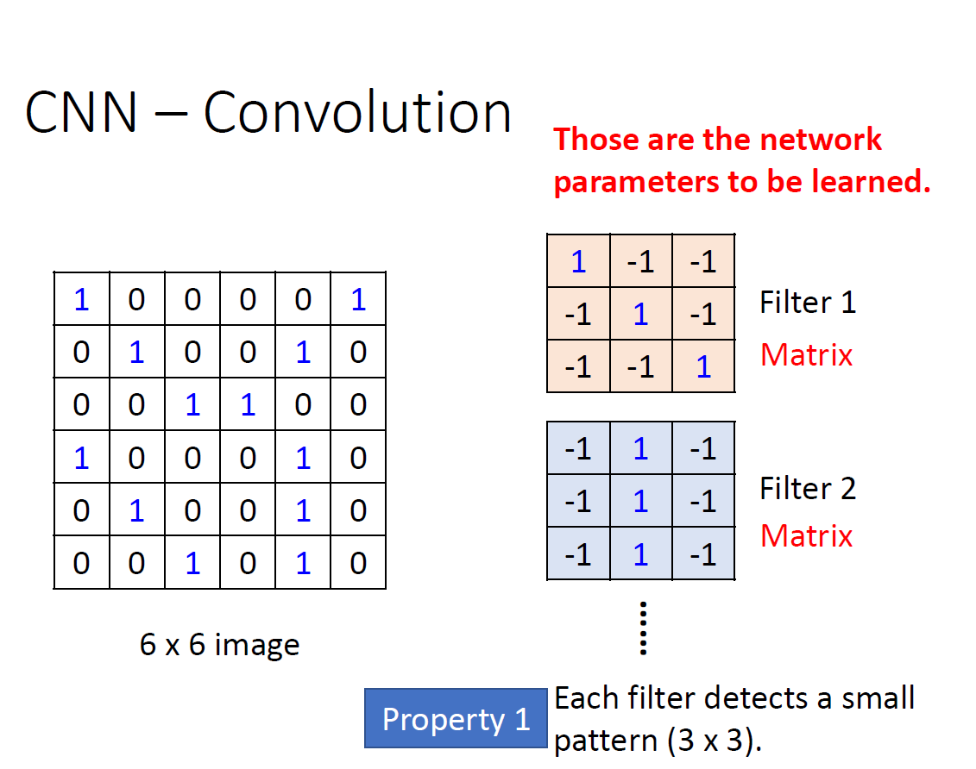
Convolutional Layers
Adjusted from Dr. Hung-yi Lee, Machine Learning slides

Slide 17
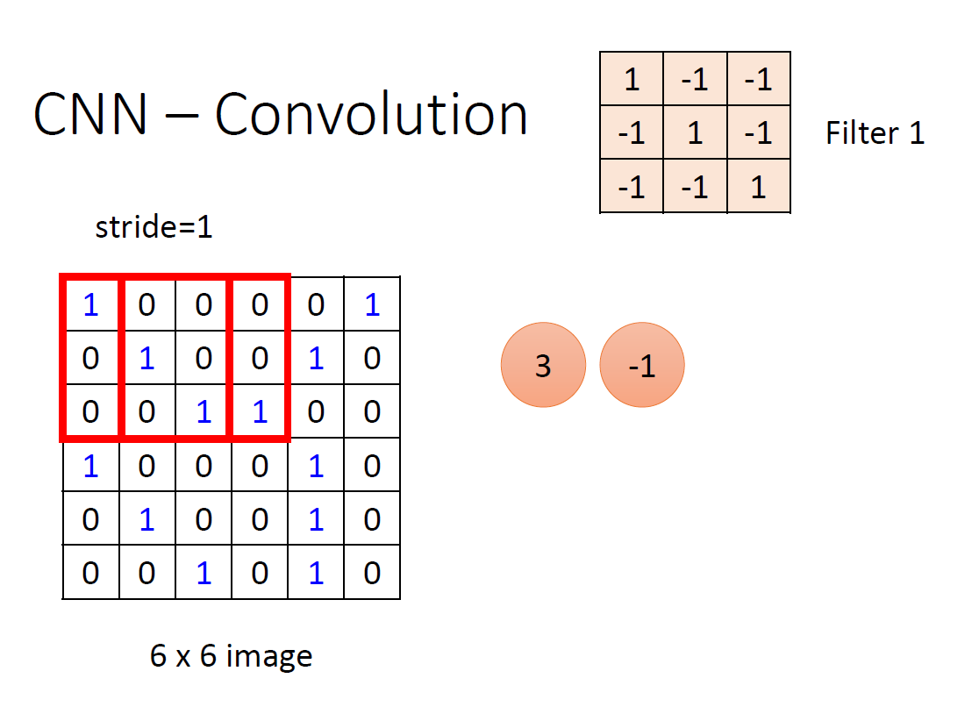
Convolutional Layers
Adjusted from Dr. Hung-yi Lee, Machine Learning slides

Slide 18
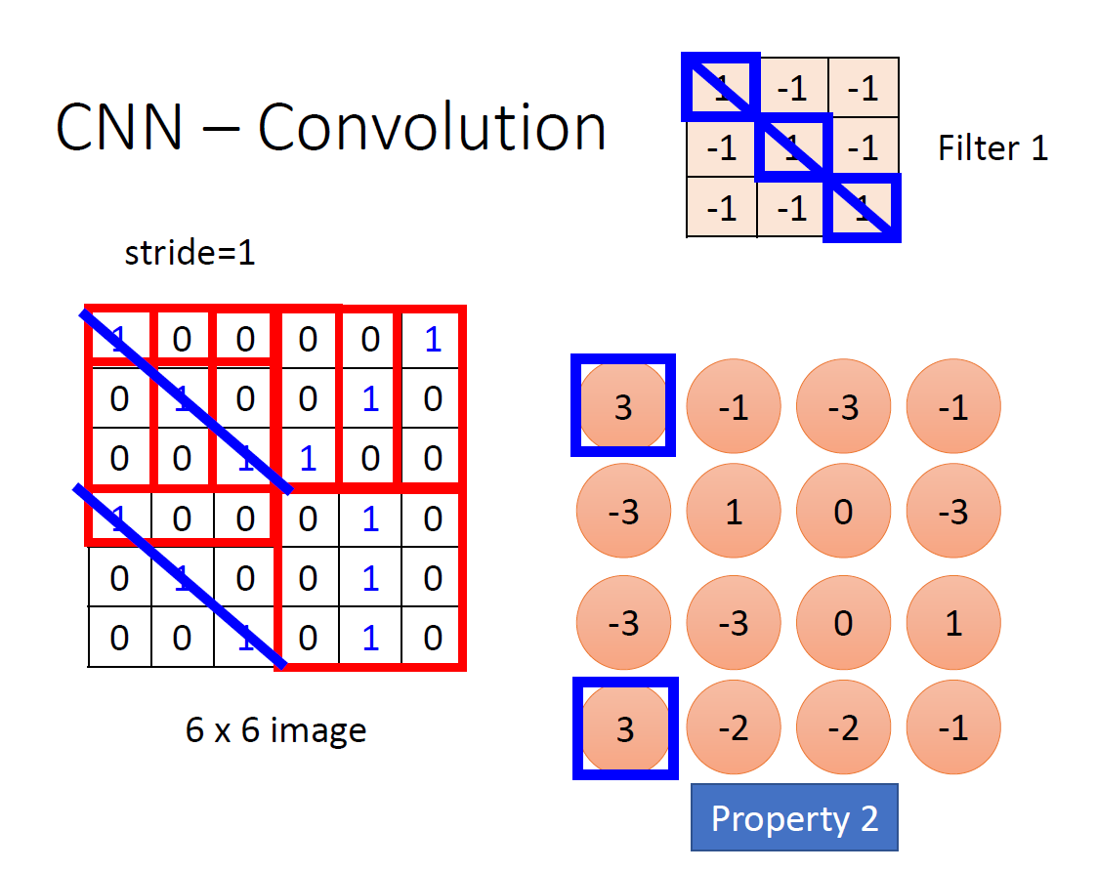
Convolutional Layers
Adjusted from Dr. Hung-yi Lee, Machine Learning slides

Slide 19
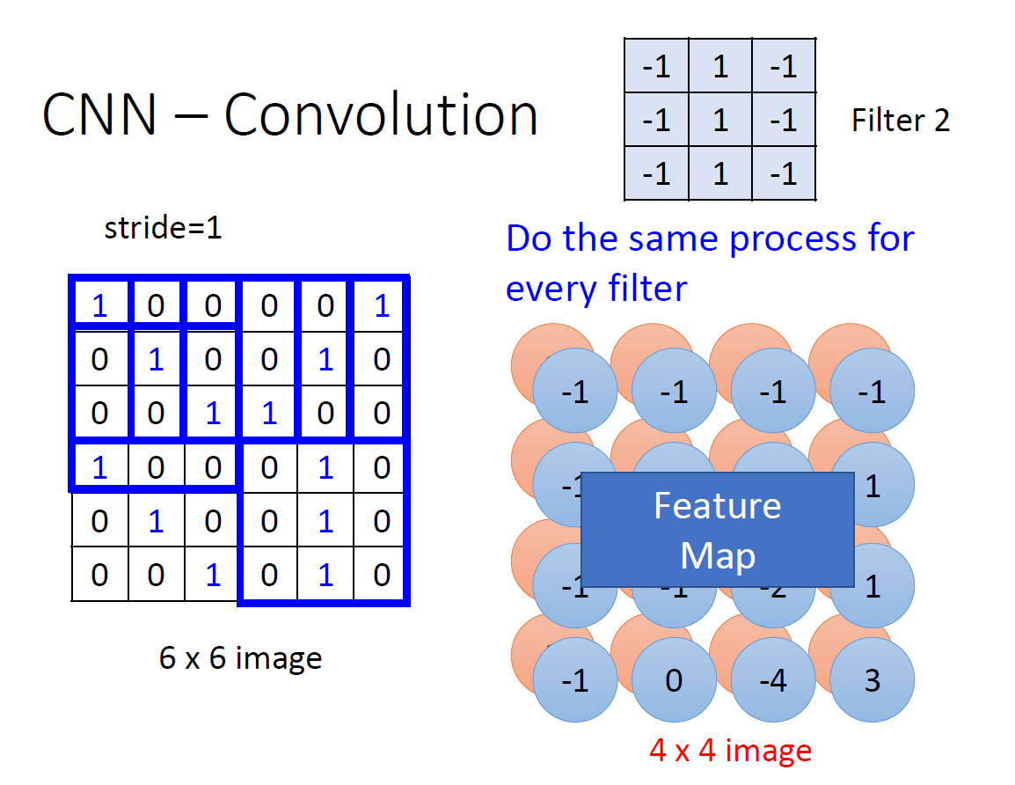
Convolutional Layers
Adjusted from Dr. Hung-yi Lee, Machine Learning slides

Slide 20
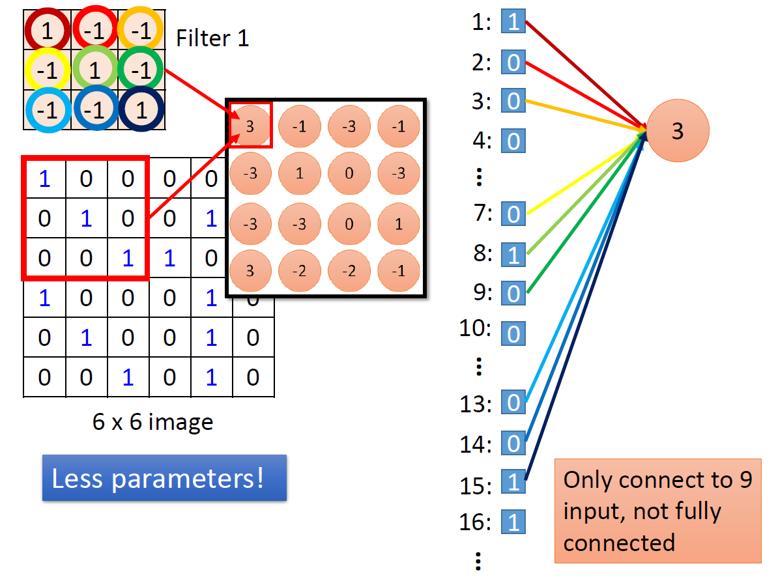
Convolutional Layers
Adjusted from Dr. Hung-yi Lee, Machine Learning slides

Slide 21
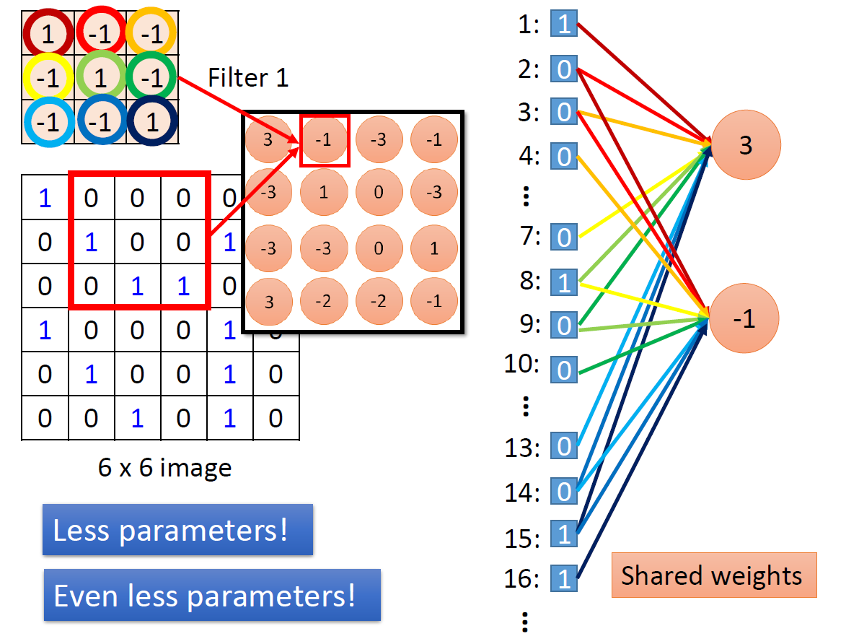
Convolutional Layers
Adjusted from Dr. Hung-yi Lee, Machine Learning slides

Slide 22
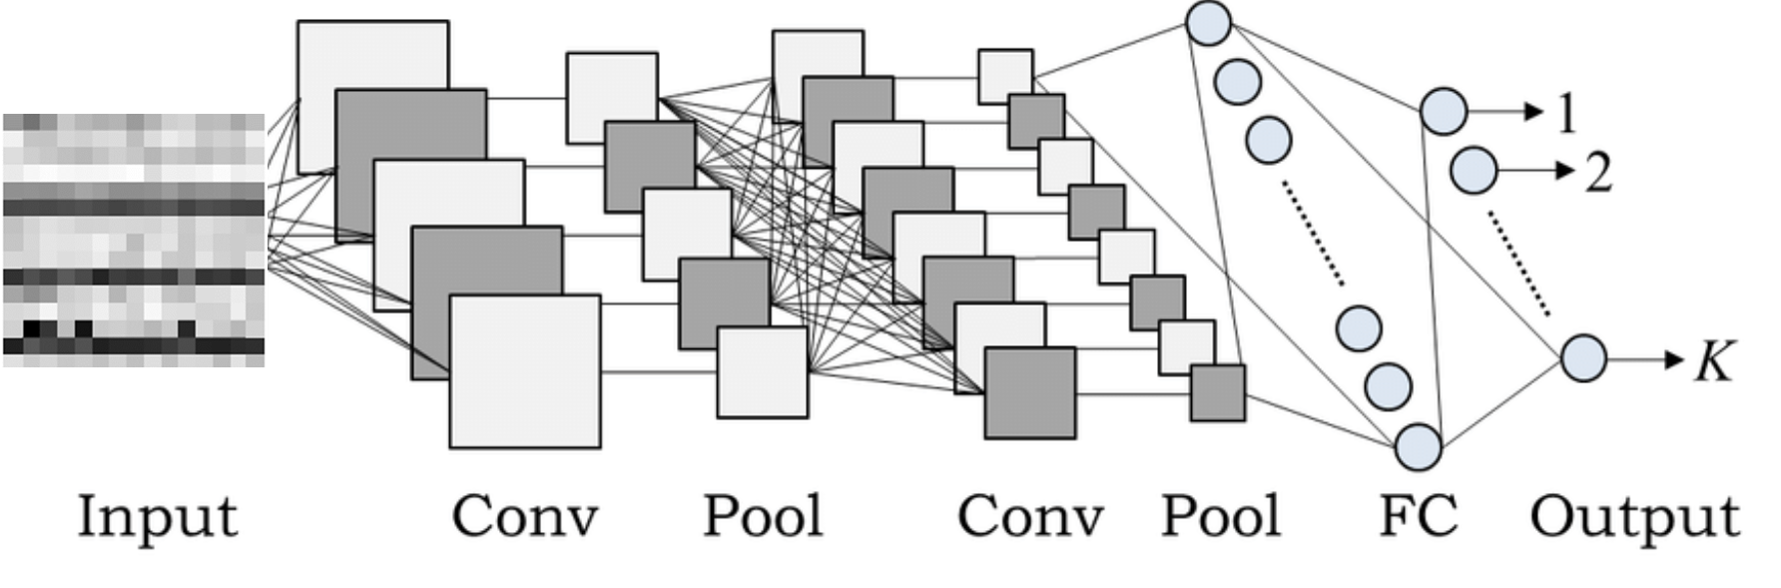
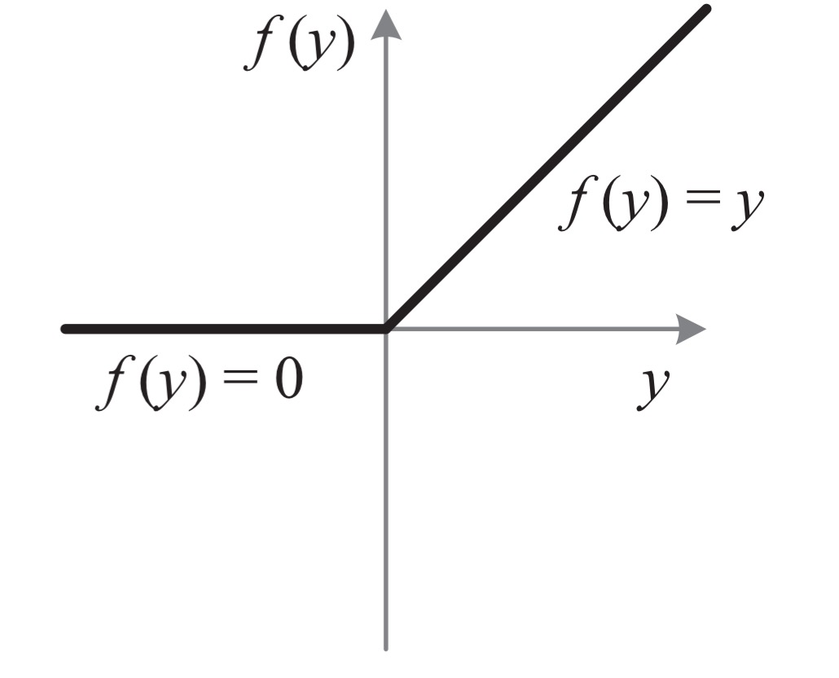
ReLU
rectified linear unit (ReLU)
Adjusted from Dr. Hung-yi Lee, Machine Learning slides

Slide 23
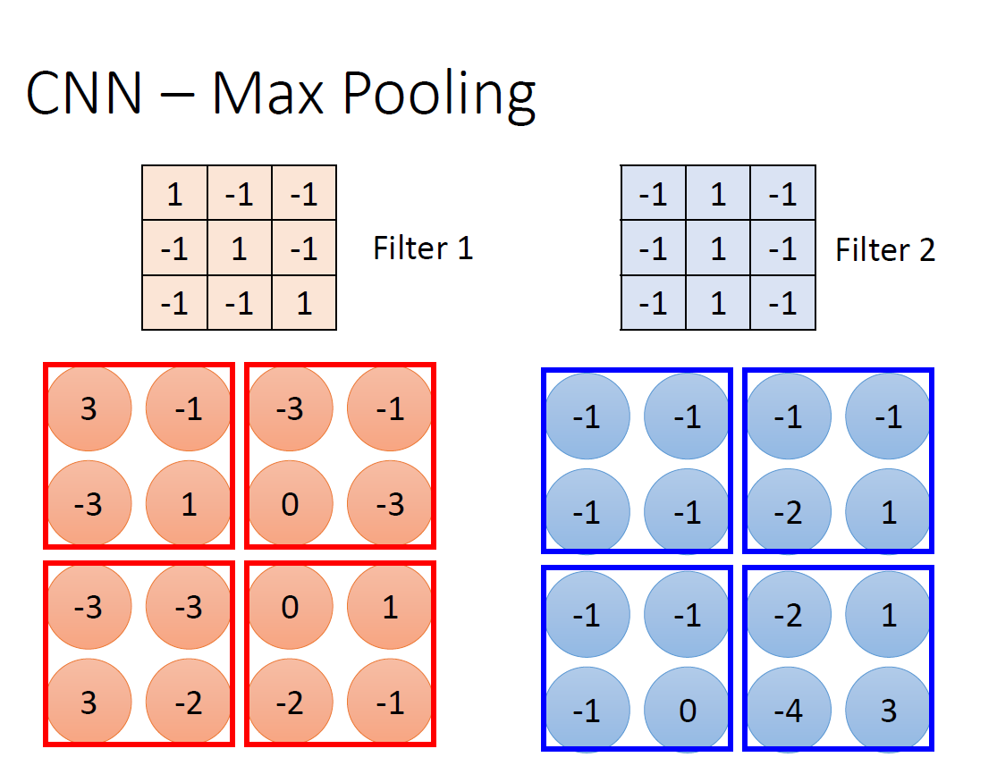
Max Pooling
Adjusted from Dr. Hung-yi Lee, Machine Learning slides

Slide 24
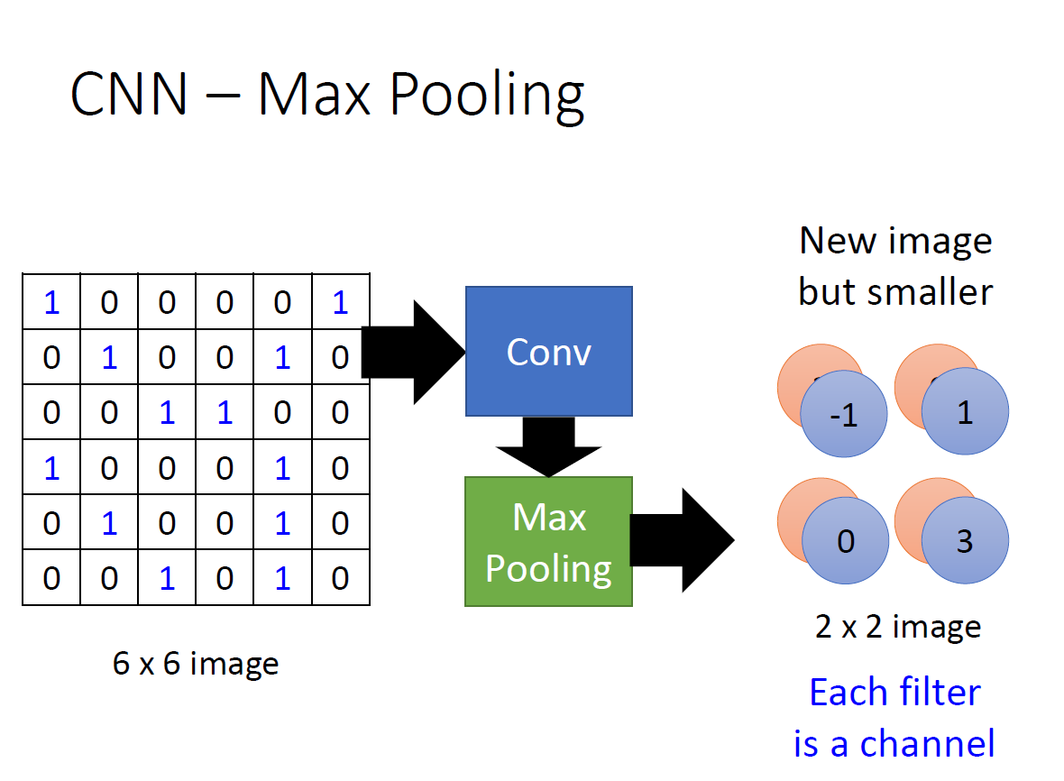
Max Pooling
Adjusted from Dr. Hung-yi Lee, Machine Learning slides

Slide 25
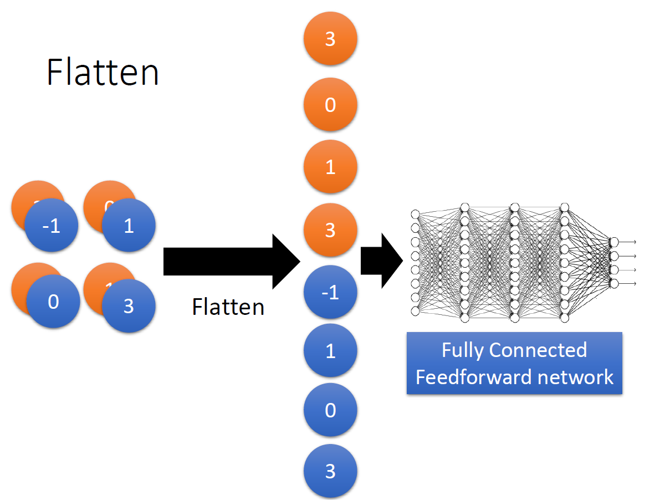
Flatten and Fully Connected
Adjusted from Dr. Hung-yi Lee, Machine Learning slides

Slide 26
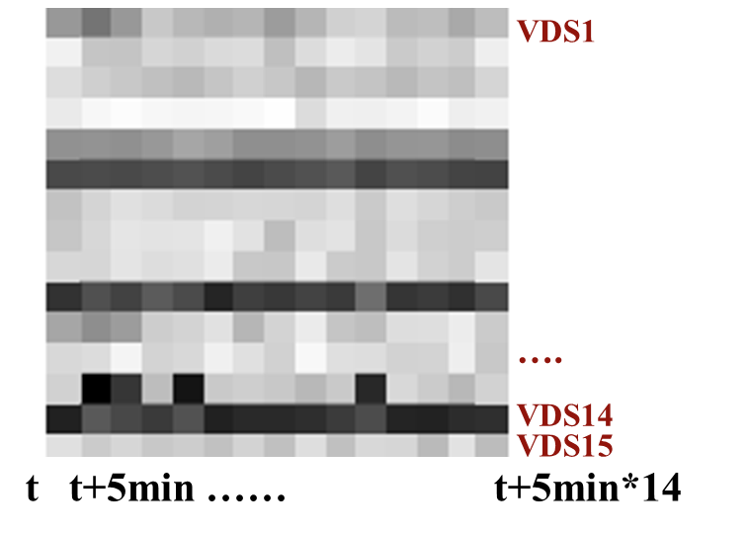
Traffic Information Detection by Filters
1 | 1 | 1
-1 | -1 | -1
-1 | -1 | -1
Bottleneck
1 | -1 | -1
1 | -1 | -1
1 | -1 | -1
Congestion
Speed Matrix
1 | -1 | -1
-1 | 1 | -1
-1 | -1 | 1
Back Propagation of Shock Wave

Slide 27
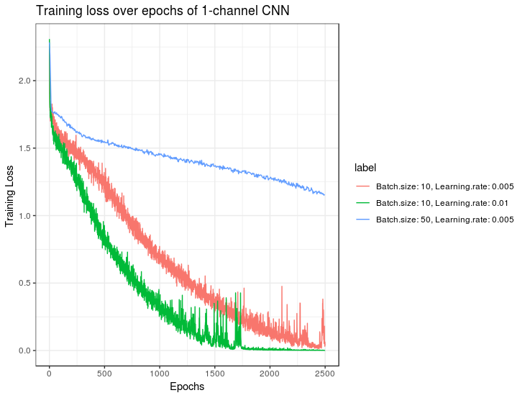
Batch size: 10 and Learning rate: 0.01 selected
1 – Channel CNN: Tuning the Network

Slide 28
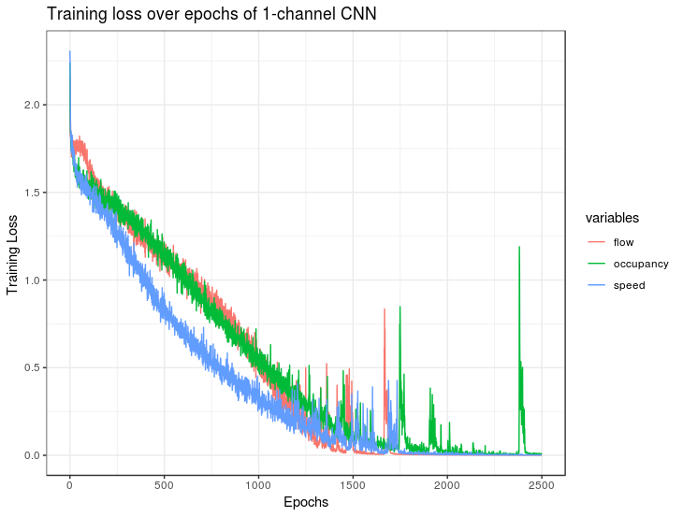
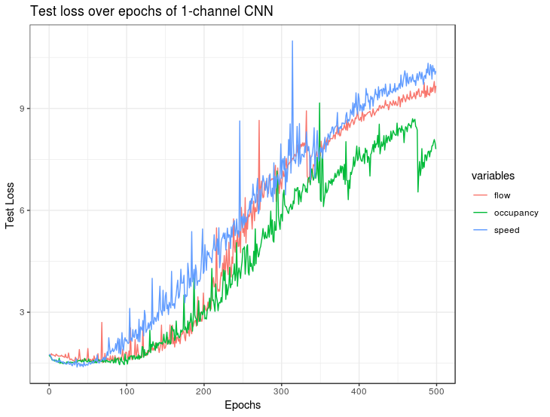
1 – Channel CNN
Training loss of 3 input variables
Test loss of 3 input variables

Slide 29
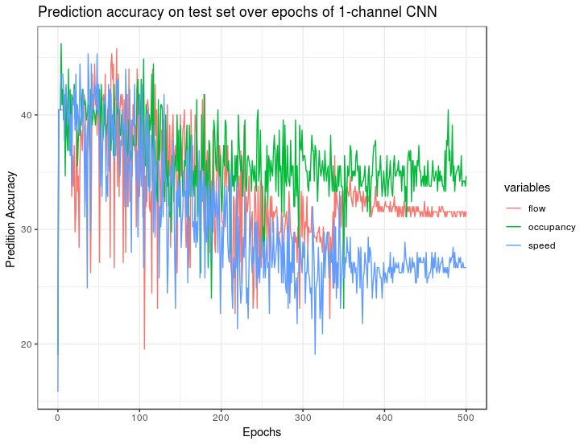
1 – Channel CNN
Prediction accuracy on test set (10/31/2018)

Slide 30
3 – Channel CNN
Speed
Flow
Occupancy

Slide 31
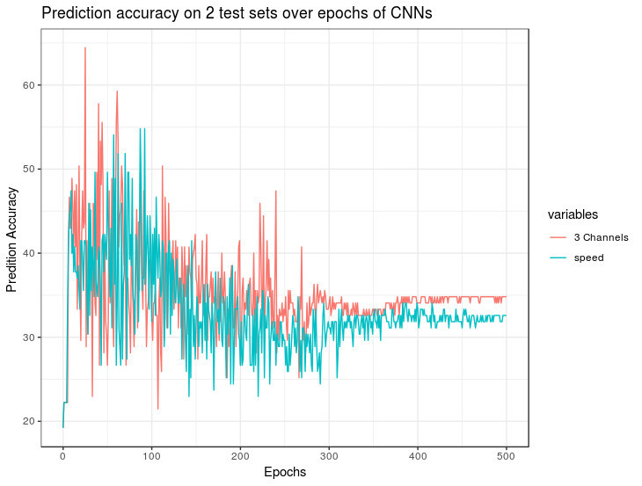
3 – Channel CNN
Prediction accuracy on 10/31 test set by 1-channel and 3-channel CNN

Slide 32
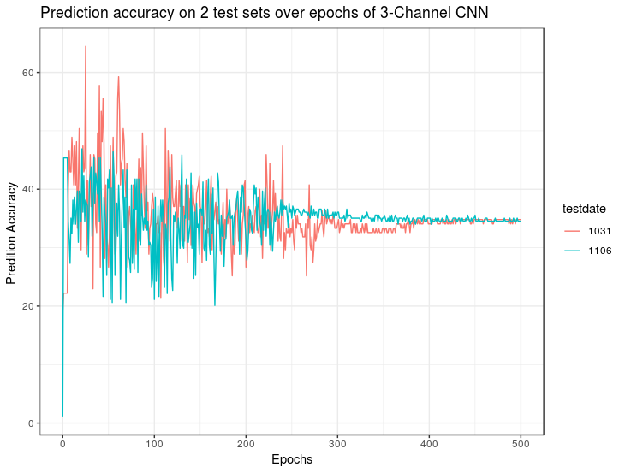
3 – Channel CNN
Performance on the test set(10/31) with the same observation rate is better than the one (11/06) with different observation rate
Prediction accuracy on 10/31 and 11/06 test sets by 3-channel CNN

Slide 33
4 – Channel CNN
Speed
Flow
Occupancy
Observation rate

Slide 34
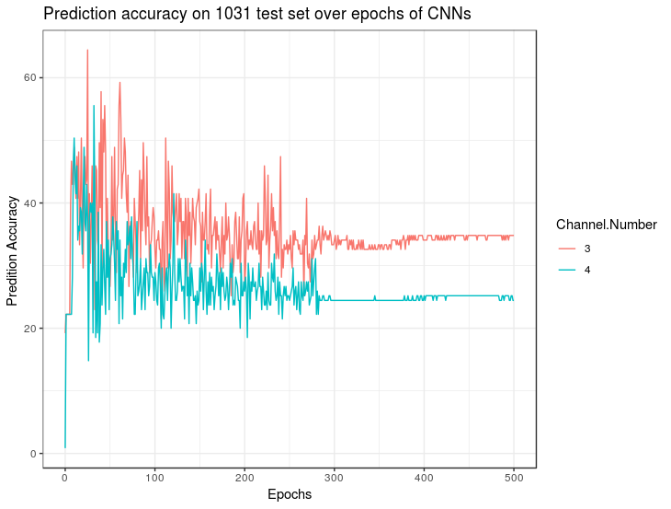
4 – Channel CNN
Prediction accuracy on 10/31 test set by 3-channel and 4-channel CNN

Slide 35
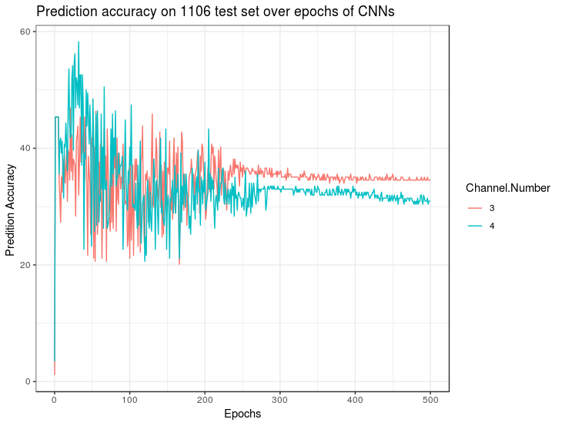
4 – Channel CNN
Prediction accuracy on 11/06 test set by 3-channel and 4-channel CNN

Slide 36
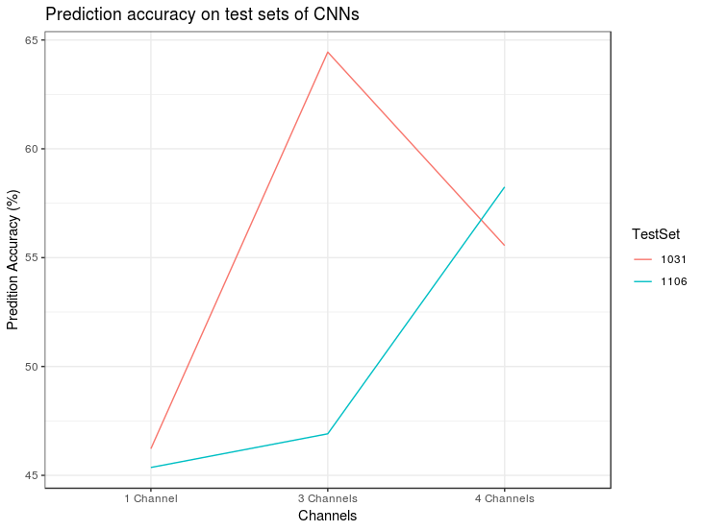
Performance of 3 CNNs
Prediction accuracy on two test sets by three CNNs

